Slide 1
E - BLOOD BANK
INSTITUTE FOR ADVANCED COMPUTING AND
SOFTWARE DEVELOPMENT
AKURDI, PUNE
PG-DAC MARCH 2023
Presentation on
Mentor:
Mrs. Rupali Solaskar Thorat
Presented By:
Ashwani Gupta(233139)
Aishwarya Patil (233176)
Group No:83

Slide 2
Introduction
BloodForLives is an online website, an outstanding way of bringing users on an online platform to provide blood bank related facilities in an efficient manner.
This website provides an Interactive interface through which a user can interact with different areas of the application easily by maintaining the blood stocks as well as user’s information.
EBB provides a simple interface and platform to ease the process of getting the information about blood availability online. It includes smooth functionality and efficiency that get the user’s work done. BloodForLives keeps the information about the blood stock and user data updated.

Slide 3
Objective
3
The main objective of the E-Blood Bank is to manage the details of Blood, Donor, Blood Group, Blood Bank Stock.
It manages all the information about Blood, Blood Cell, Stock, Blood. The project is totally built at administrative end and thus only the administrator is guaranteed the access.
The E- blood bank is a unique designed system provides services to the hospitals and other users.
The system is easy to maintain all the information about the blood donor/consumer.
Proposed work provides services to persons who pursue donors who are willing to donate blood.

Slide 4
Technologies Used
We used Java Spring-Boot as backend and React JS as Frontend in our Project.
Spring-Boot :–
The main goal of the Spring Boot framework is to reduce overall development time and increase efficiency. React has become the first choice for frontend because it gives developers the ability to work with a virtual browser (more friendly than the real browser). Also, a JavaScript developer can become a productive developer in a few hours because there is a small API to learn, a few functions, and how to use them…
React :–
React allows developers to create large web applications that can change data, without reloading the page. The main purpose of React is to be fast, scalable, and simple.
MySQL :–
MySQL database has been used as database for the project.

Slide 5


User Classes
In this module admin can add users in system also admin can manage all blood stocks and donation history.
In this module user can see profile .user can take appointment for blood consumption. User can view donation history .
Administrator
User

Slide 6
Product Functions
Recording information about the blood donation history.
Managing user information.
Managing Events related to blood bank .
Managing appointments for the blood consumptions by user.
Recording information about the blood consumption history
Managing address details of a user.
Managing blood stocks availability in blood bank.

Slide 7
Admin module
Admin can manage blood stocks by adding or removing the blood units available on the system.
Admin can approve or reject the appointments generated by the user for blood need.
Admin can manage the event by adding a new event or removing the existing one.
Can see the existing user and their Id verification status.
Also can approve the ID verification requests or reject them.

Slide 8
User module
User can donate and consume blood.
User can see the available blood stocks in the blood bank.
Can take appointments for the blood consumption.
User can see the upcoming events and its description.
User can modify their information as per requirement.

Slide 9
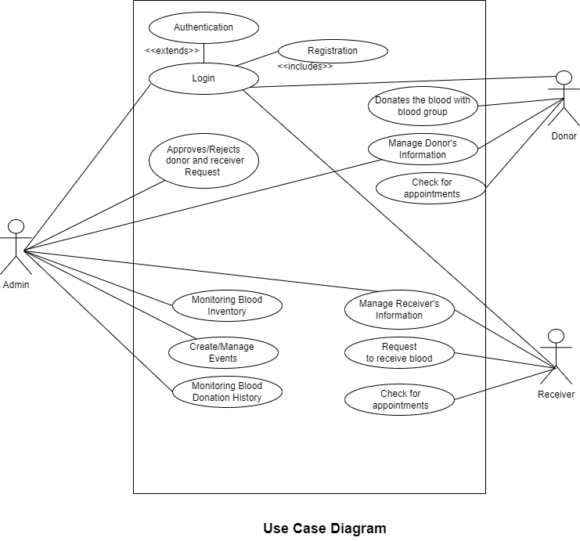

Slide 10
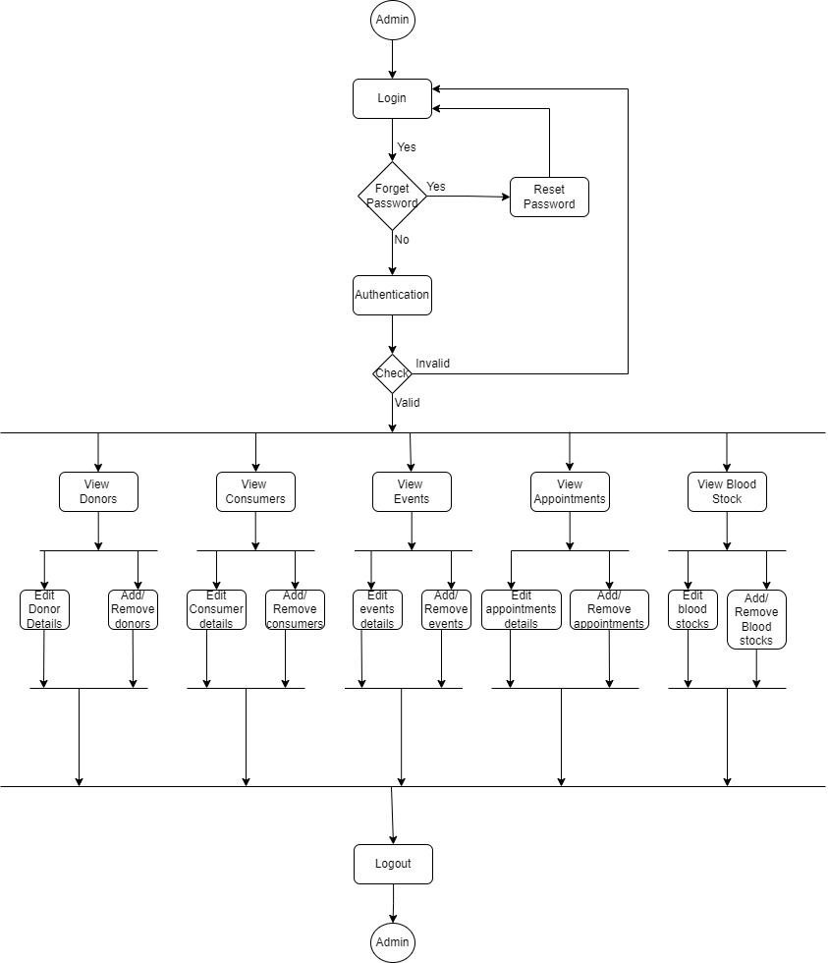
Activity diagram : Admin module

Slide 11
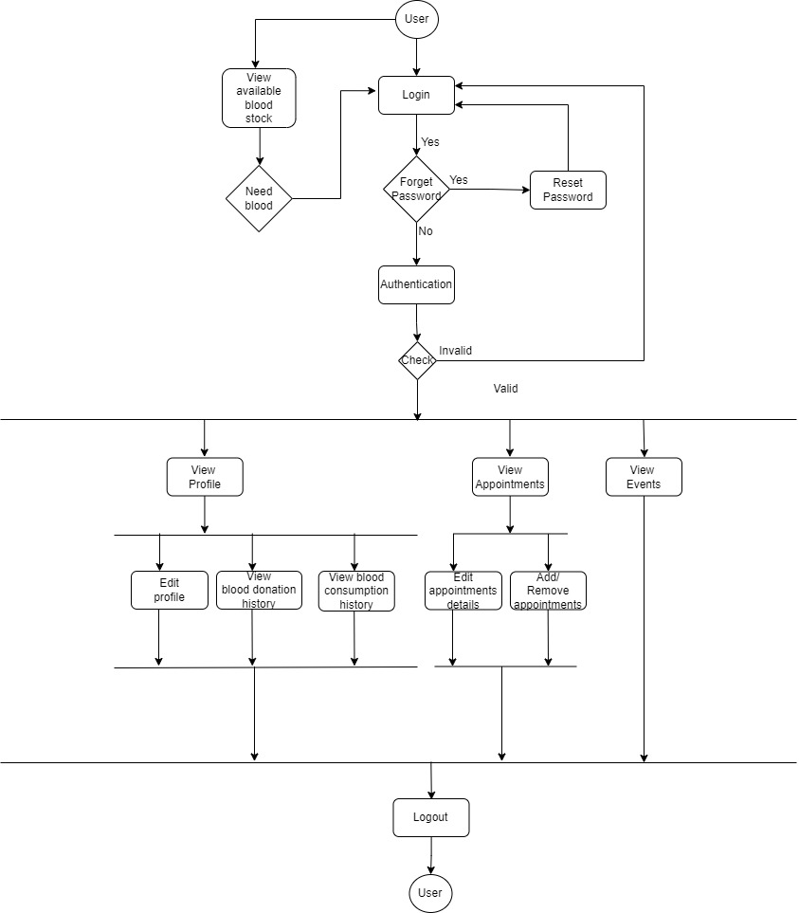
Activity diagram : User module

Slide 12
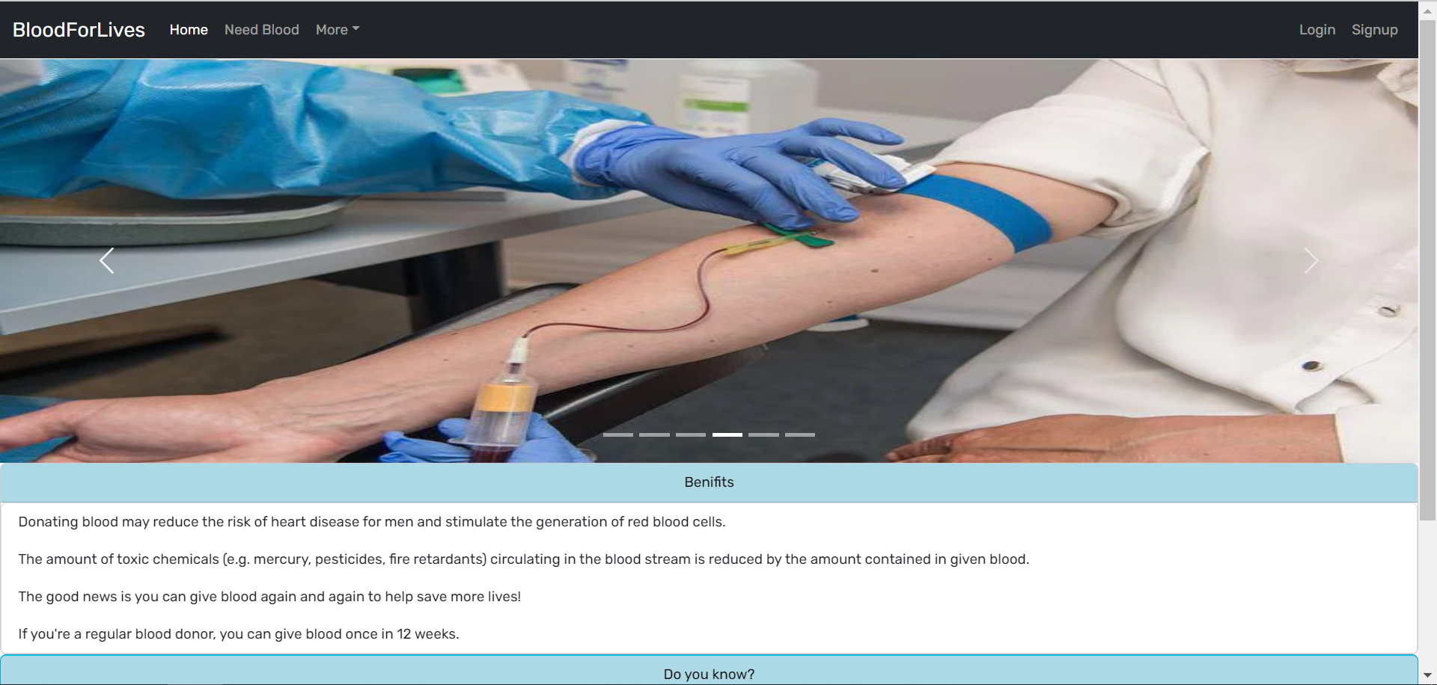
Home Page

Slide 13
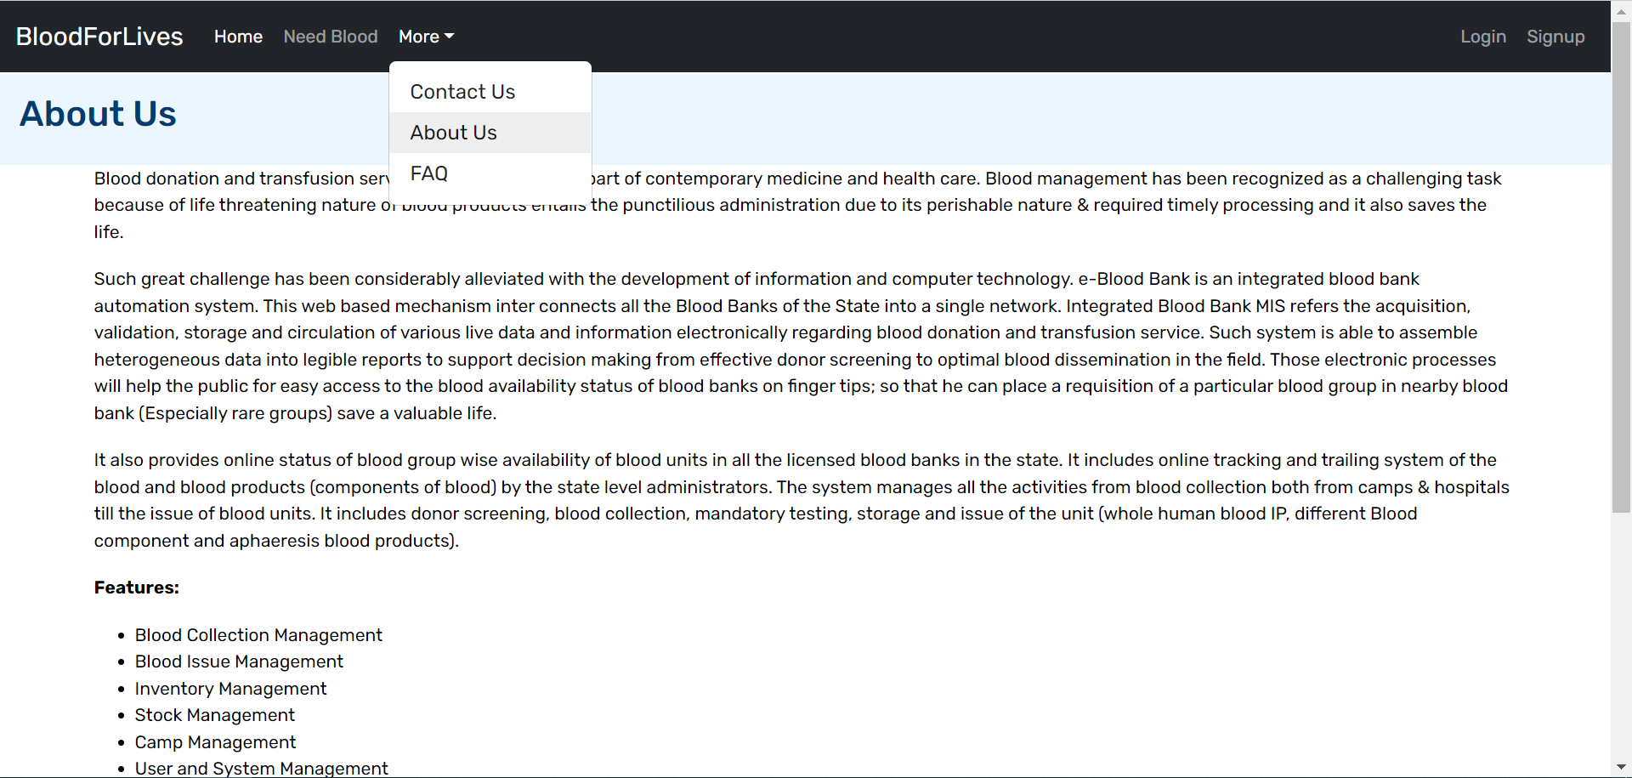
Home Page

Slide 14
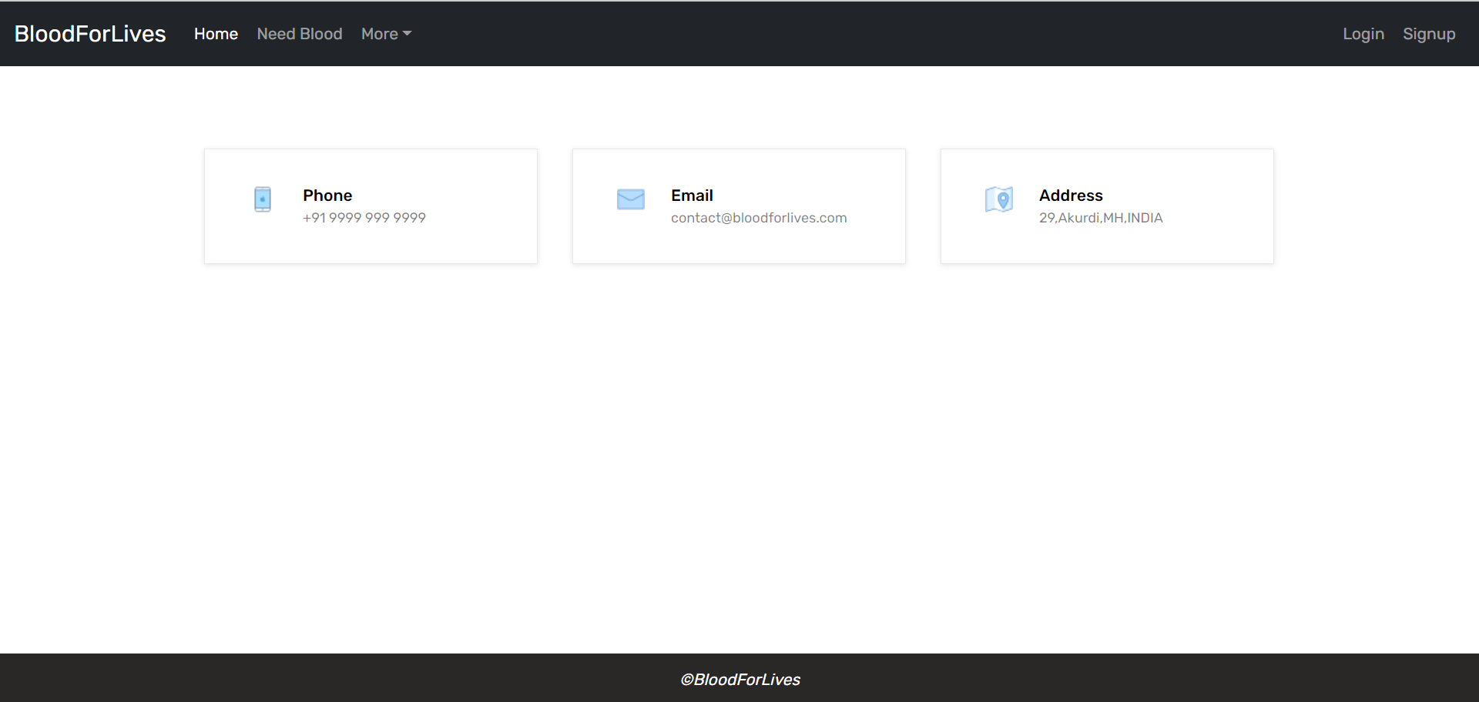
Home Page

Slide 15
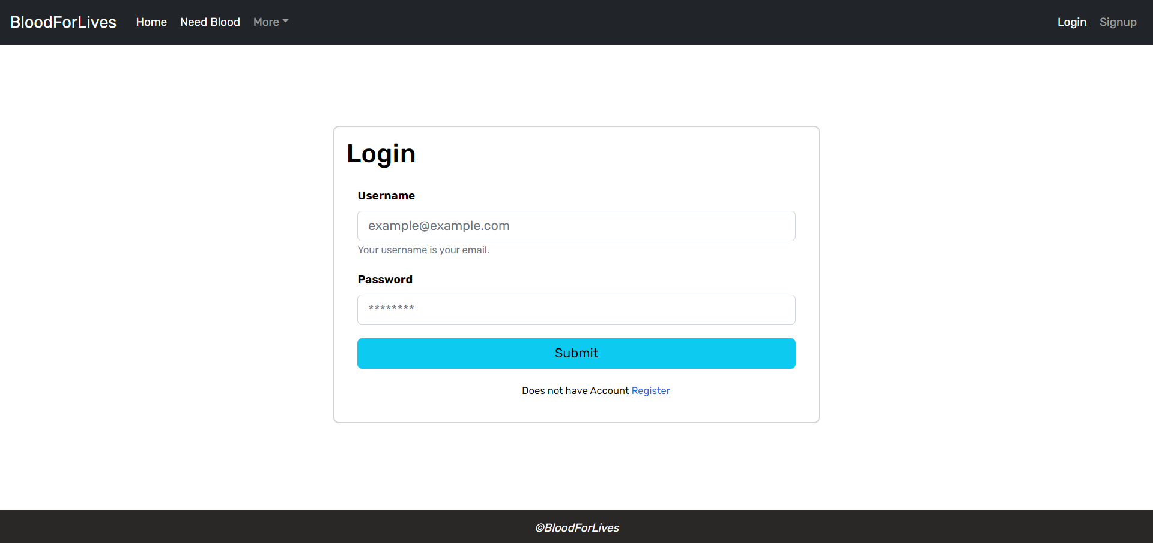
Login Page:

Slide 16
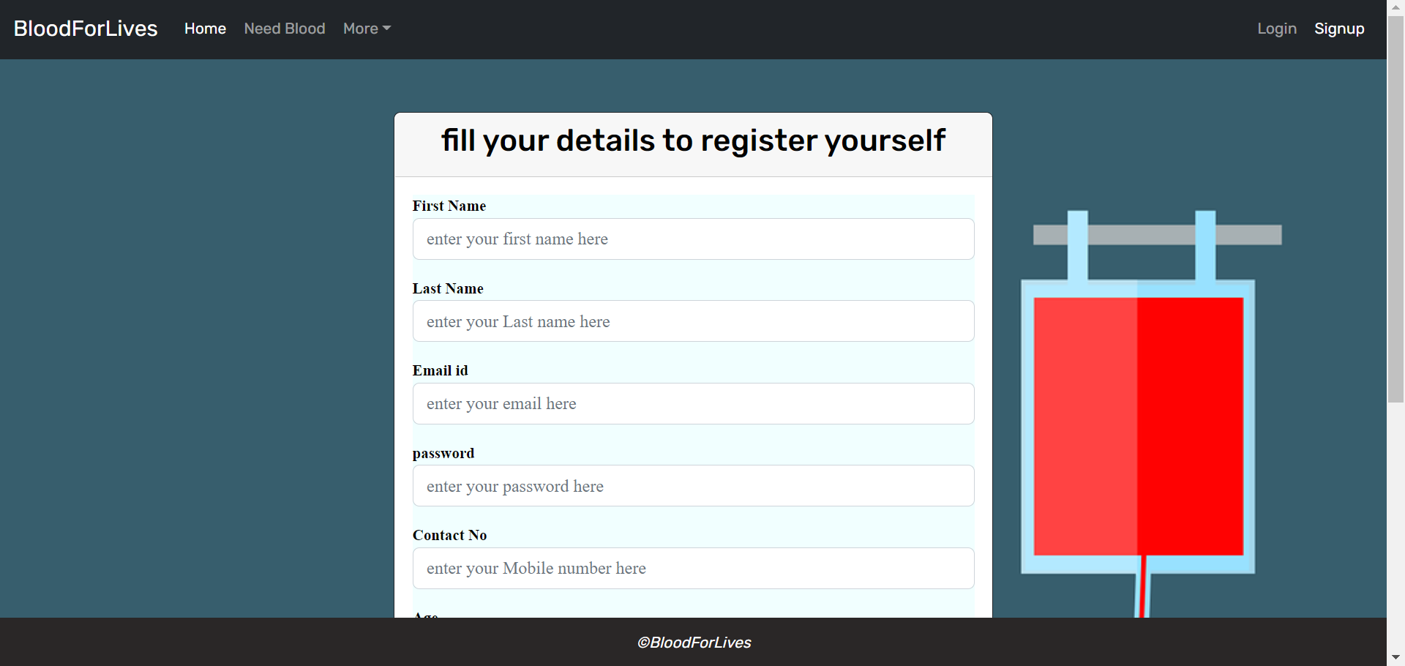
Sign up Page:

Slide 17
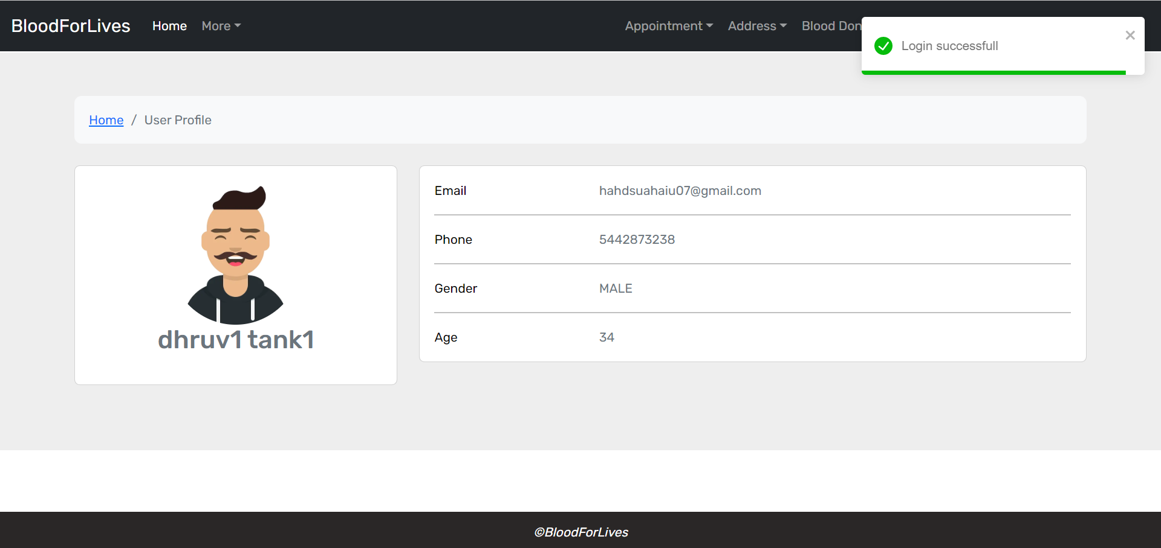
User Flow(Home page)

Slide 18
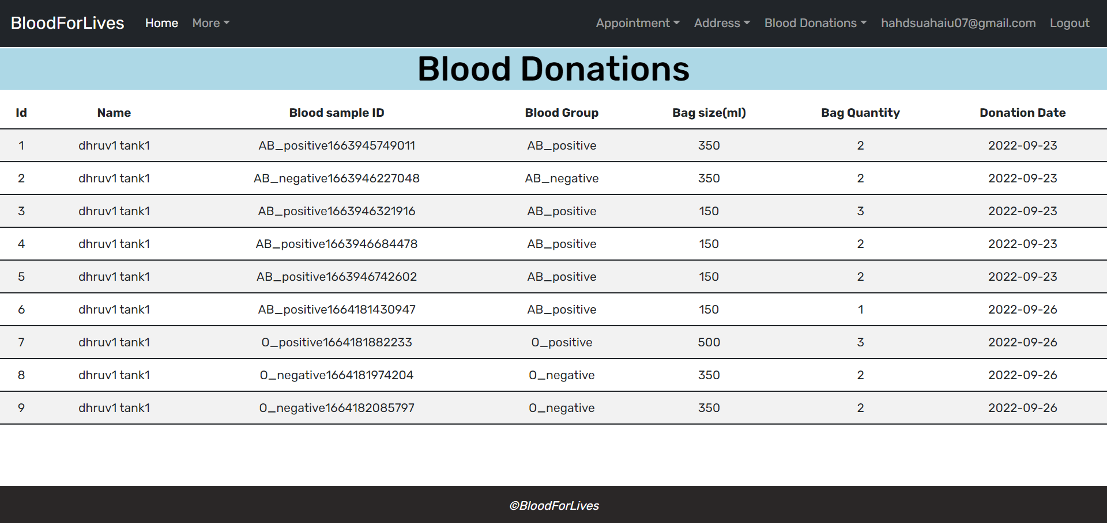
User Flow:

Slide 19
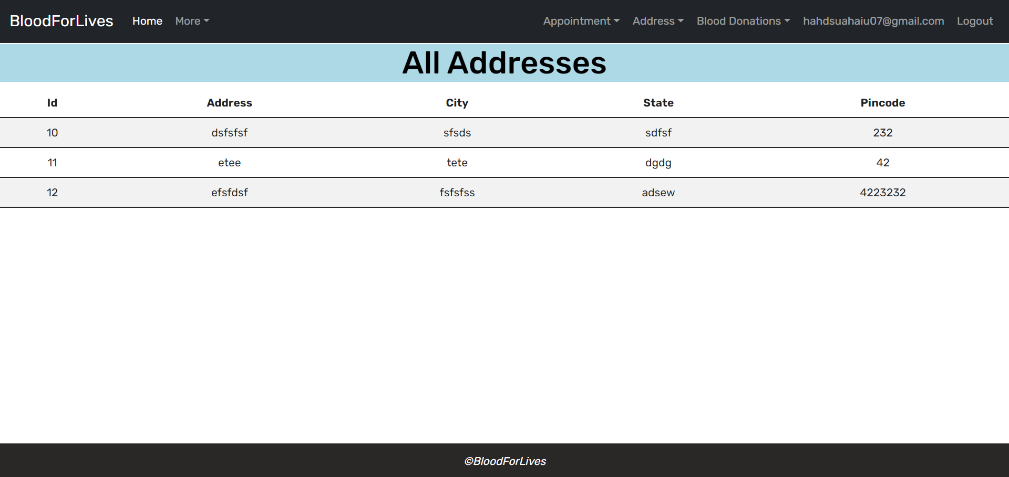
User Flow:

Slide 20
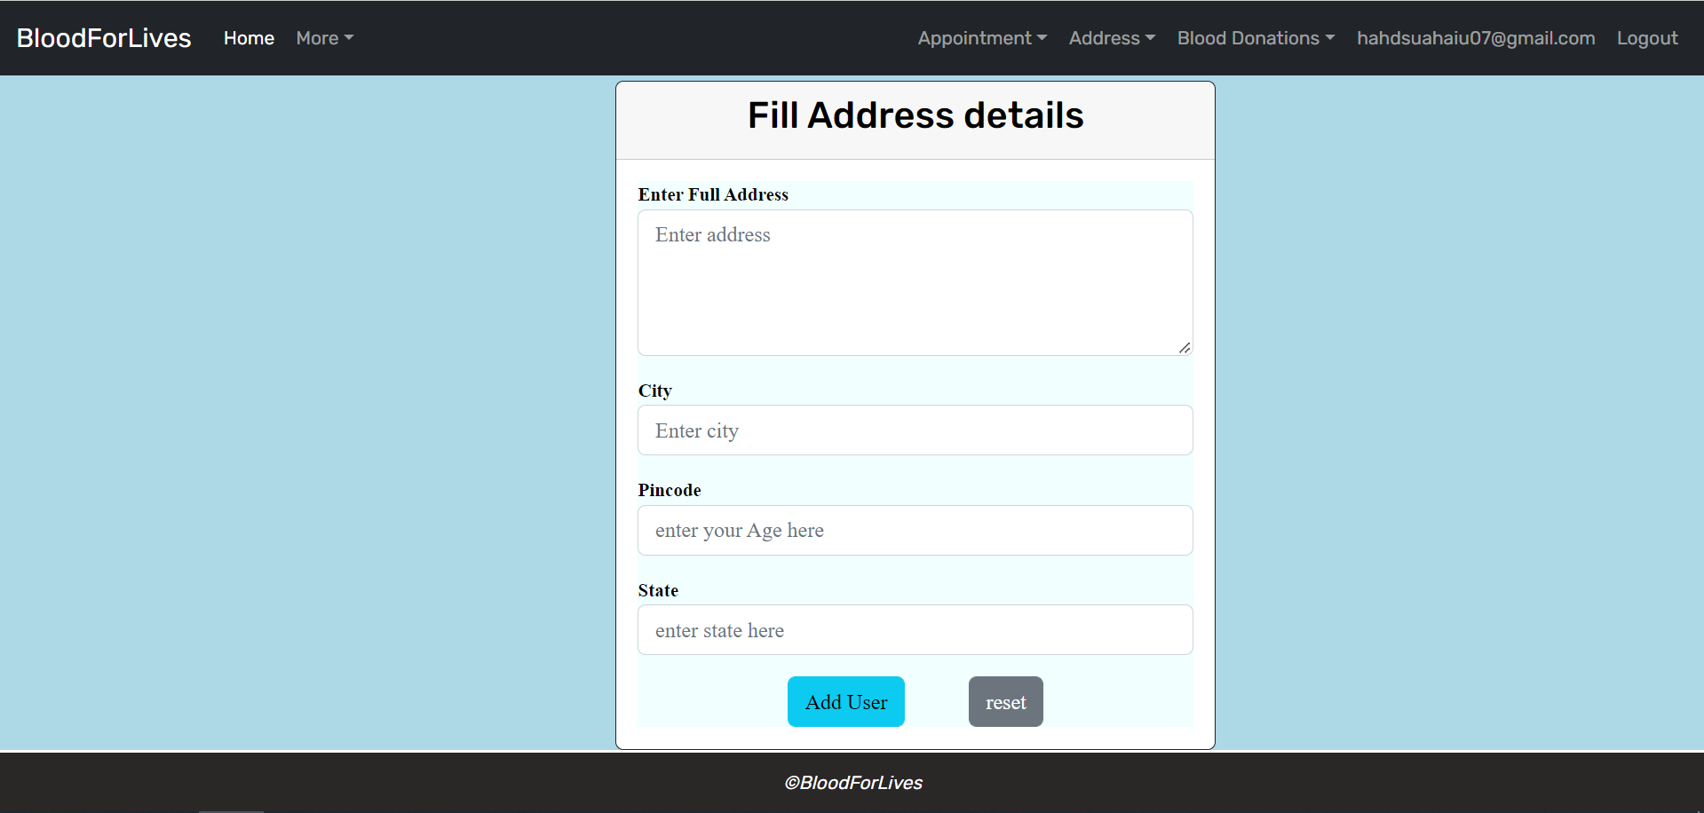
User Flow:

Slide 21
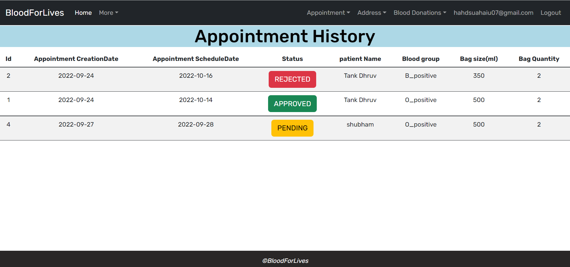
User Flow:

Slide 22
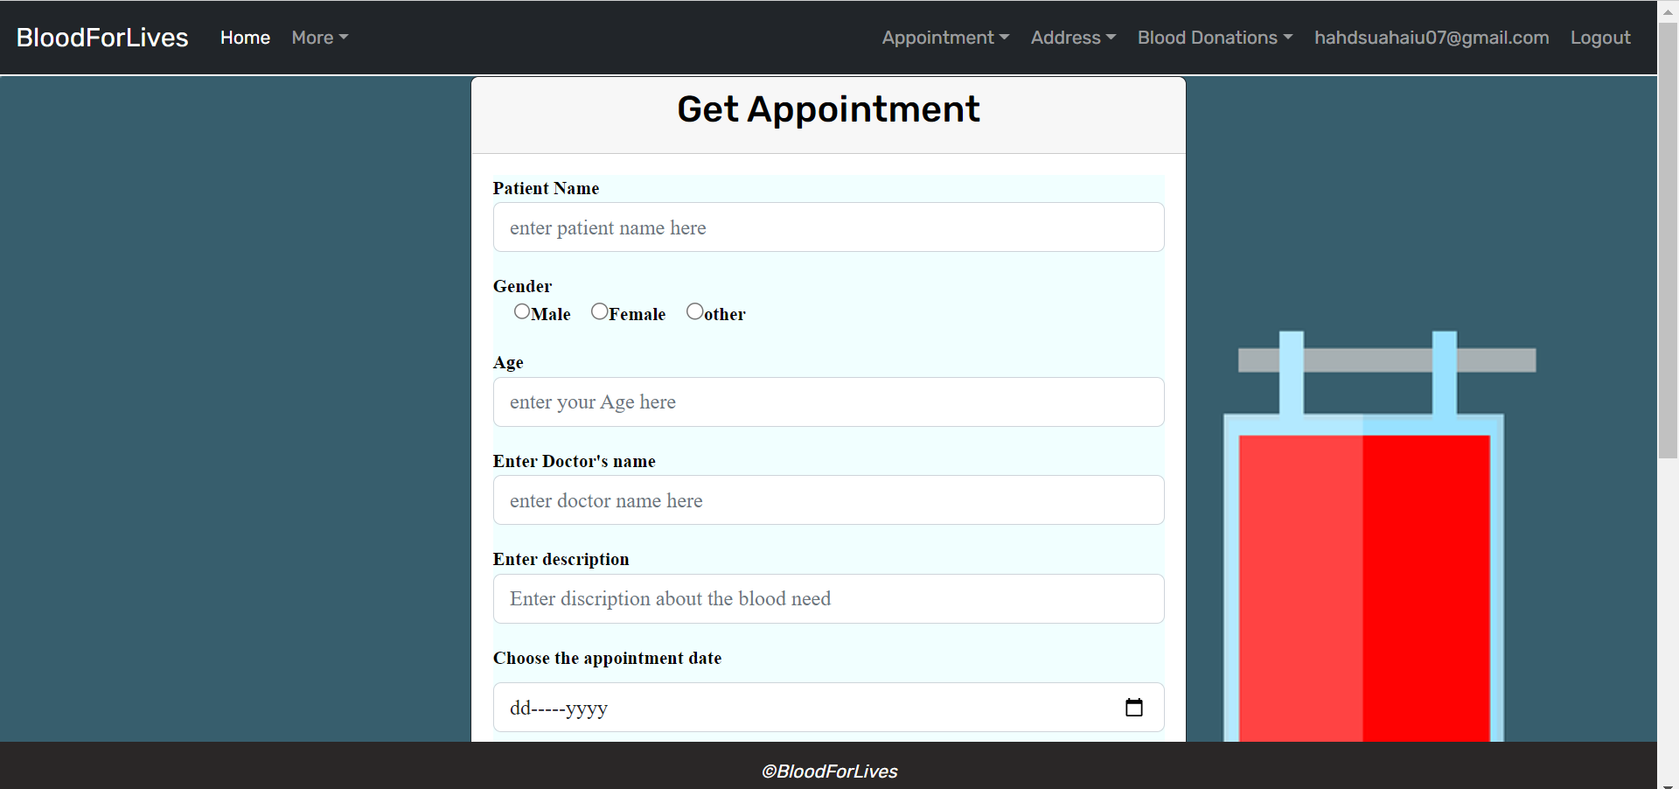
User Flow:

Slide 23
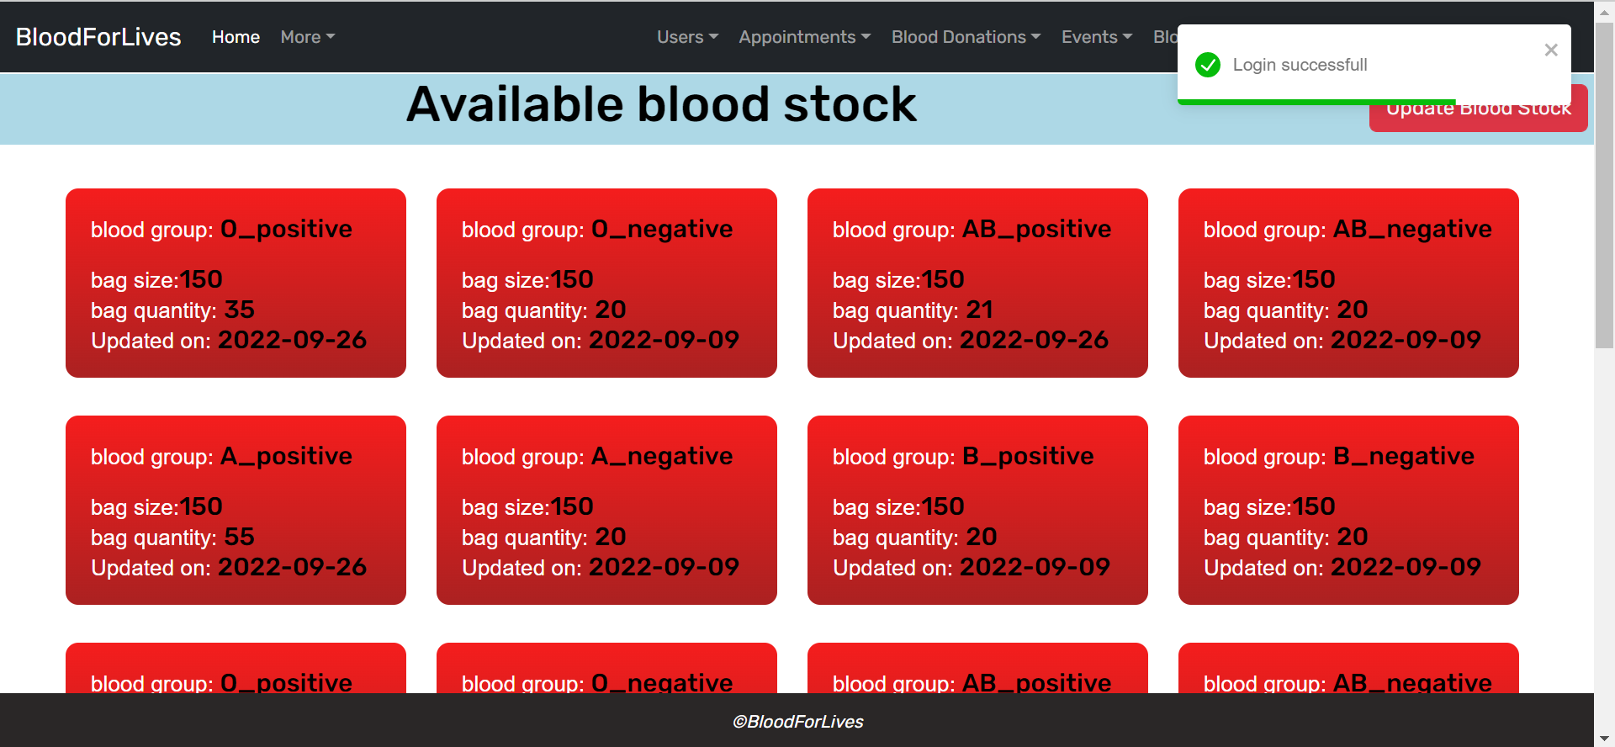
Admin Flow:

Slide 24
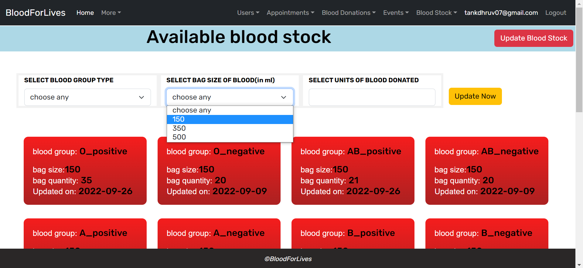
Admin Flow:

Slide 25
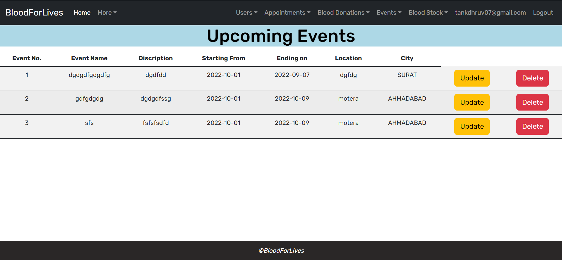
Admin Flow:

Slide 26
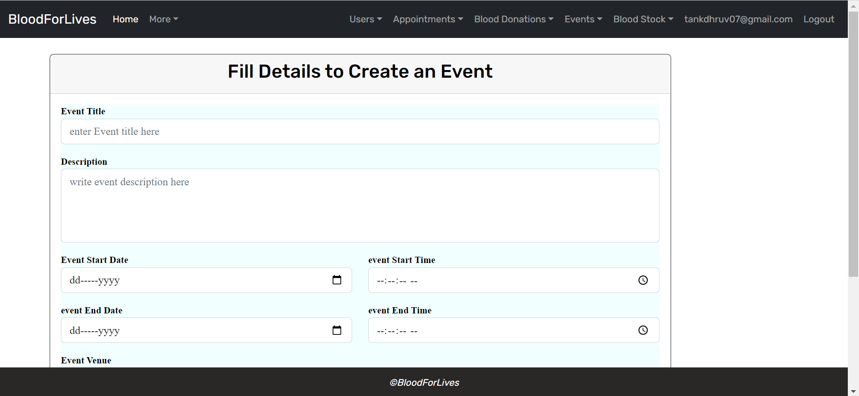
Admin Flow:

Slide 27
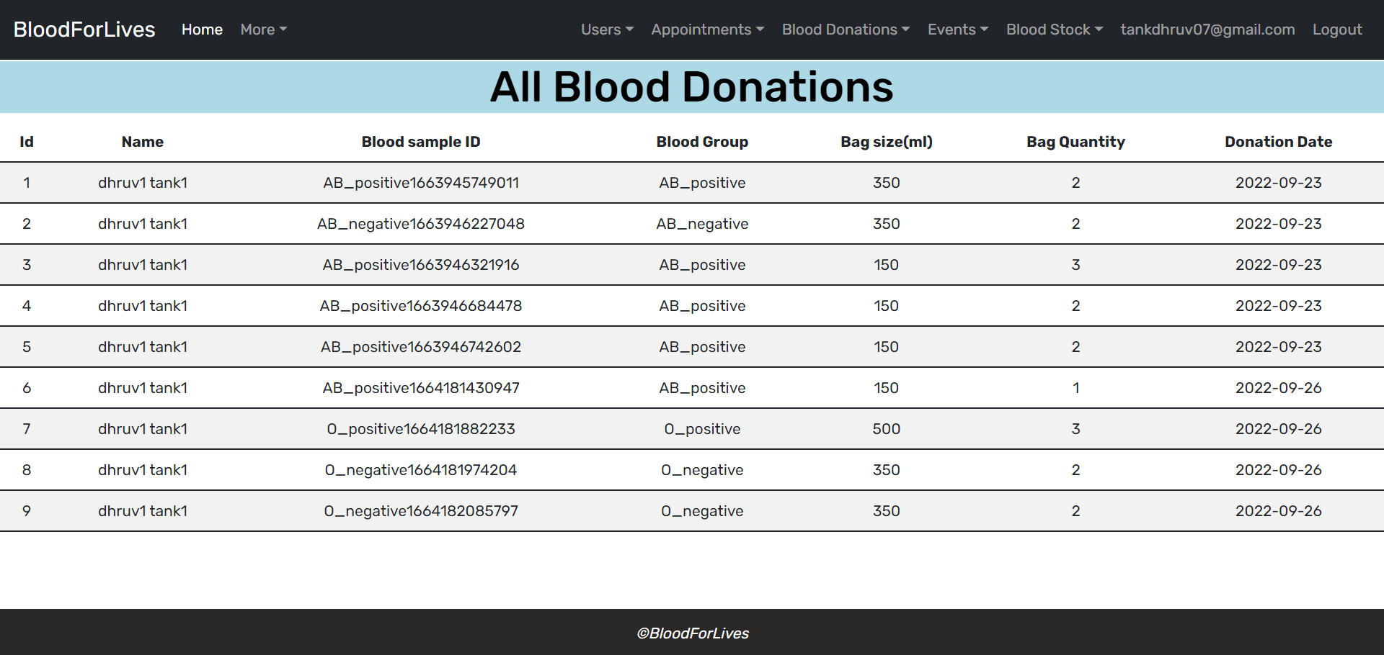
Admin Flow:

Slide 28
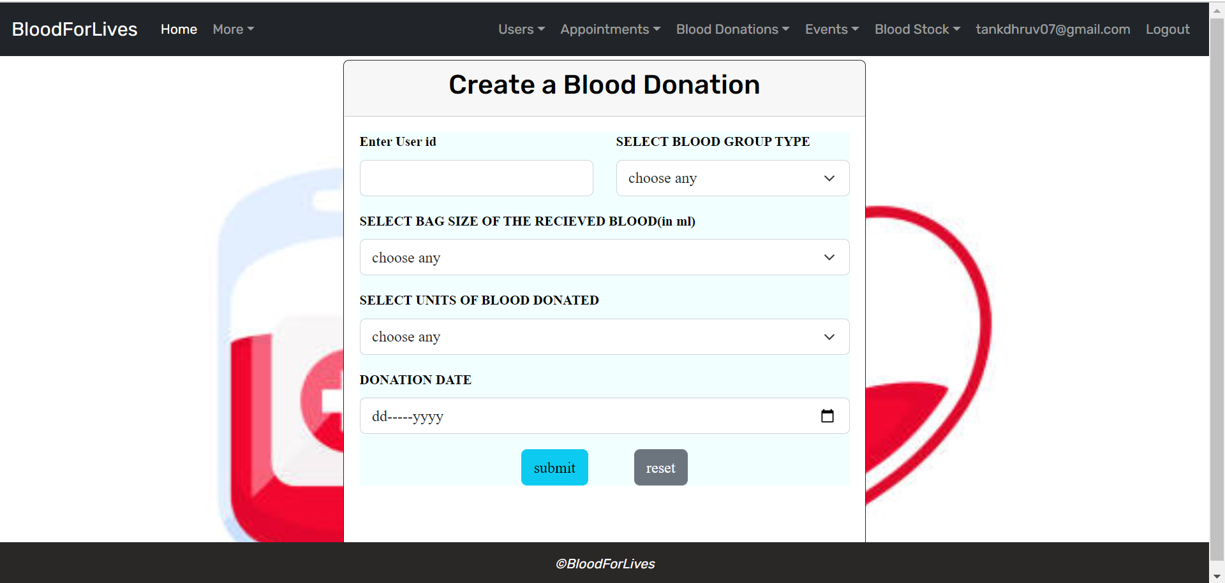
Admin Flow:

Slide 29
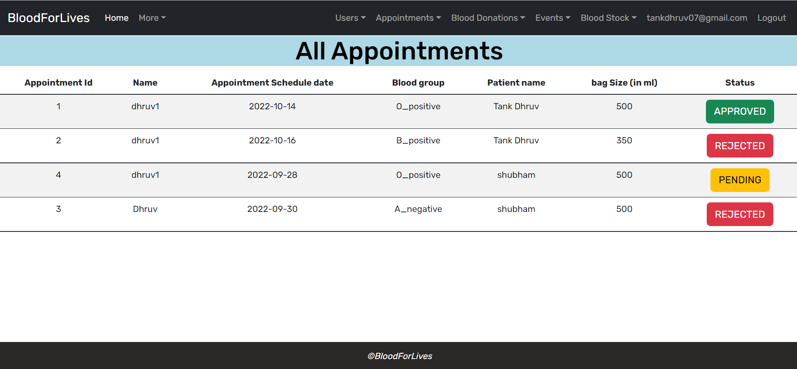
Admin Flow:

Slide 30
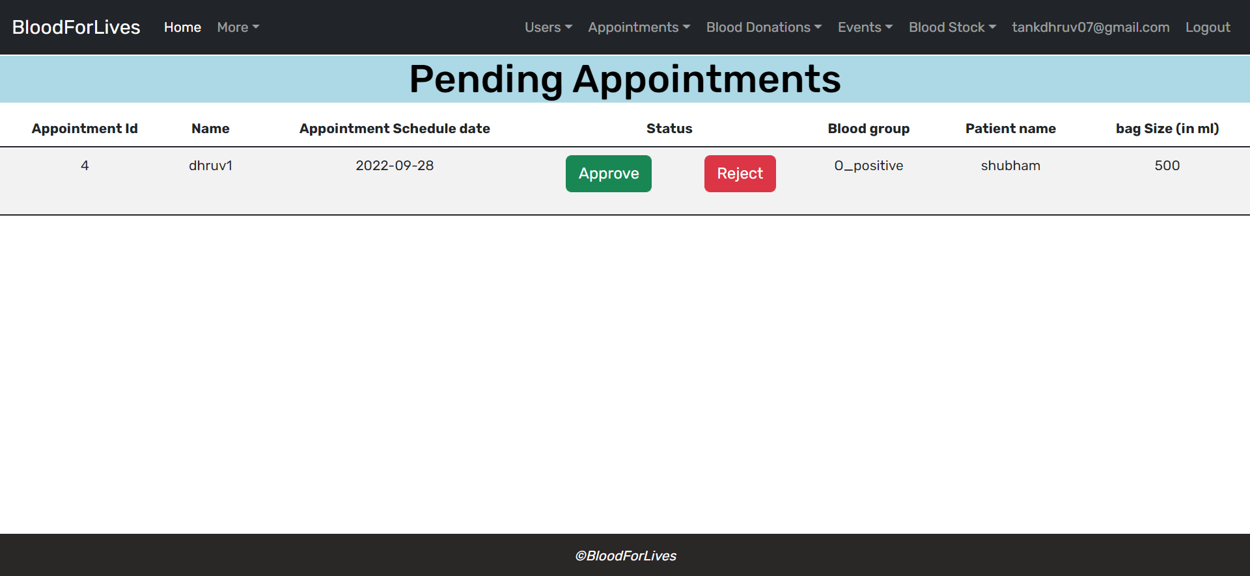
Admin Flow:

Slide 31
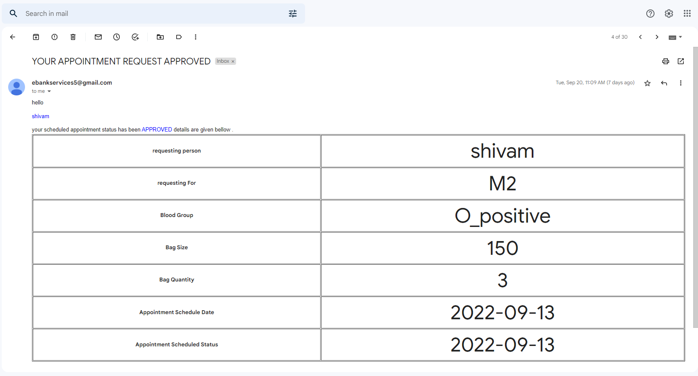
Admin Flow:

Slide 32
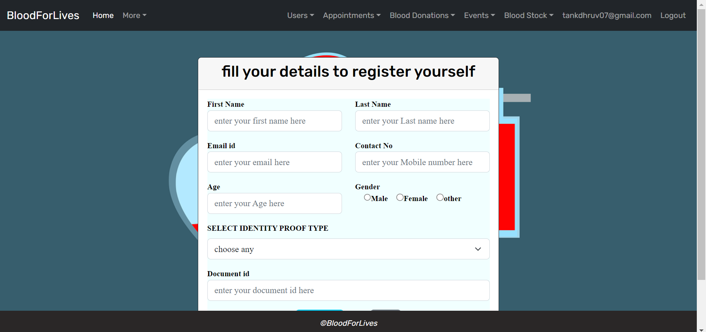
Admin Flow:

Slide 33
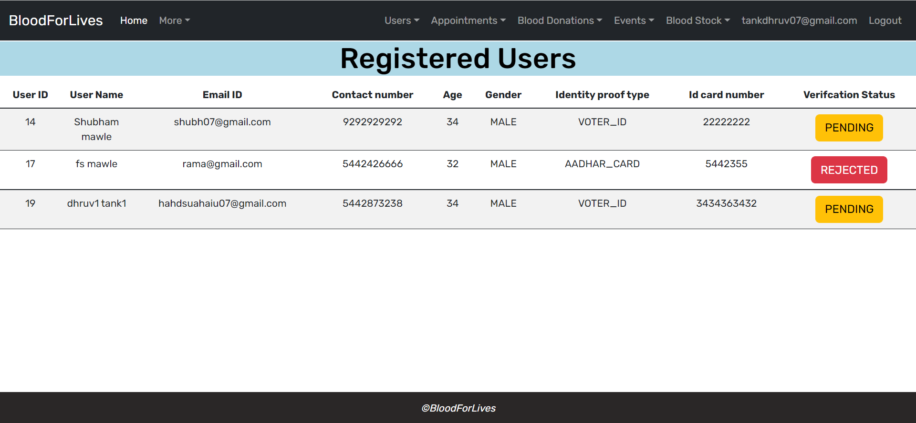
Admin Flow:

Slide 34

FUTURE SCOPE
This project can be enhanced further by adding some more features. The application is design in such a way that any further enhancements can be done with ease.
The system has the capability for easy integration with other systems.
New modules can be added to the existing system with less effort.
In future a new function or procedure can be easily added in the system through these classes. Or even a new class can be added.
There is a scope for further development in our project to a great extent. A number of features can be added to this system in future like combining hospitals with this project. Also making dashboard more user’s friendly. Also generate blood donation certificate
IACSD,PUNE

Slide 35
CONCLUSION
It has been a great pleasure for us to work on this exciting and challenging project. This project proved good for us as it provided practical knowledge of not only programming in JAVA and JavaScript web based application and no some extent Windows Application and SQL Server, but also about all handling procedure related with E- Blood Bank.
It also provides knowledge about the latest technology used in developing web enabled application and client server technology that will be great demand in future. This will provide better opportunities and guidance in future in developing projects independently.
IACSD,PUNE

Slide 36
REFERENCES
React Tutorial (w3schools.com)
Learn Spring Boot | Baeldung
Spring Data JPA - Reference Documentation
React – A JavaScript library for building user interfaces (reactjs.org)
Bootstrap · the most popular HTML, CSS, and JS library in the world. (getbootstrap.com)
www.Google.com
www.w3school.com
www.javatpoint.com https://docs.spring.io/spring-framework/docs
https://getbootstrap.com/docs/4.0

Slide 37



THANK YOU
PG –DAC/DITISS
Centre for Development of Advanced Computing

